Slide 1

Digital Electronics (303105220)
Alpita makwna, Assistant Professor
Mechatronics Engineering

Slide 2
CHAPTER-5
A/D and D/A Converters
Digital to analog converters: weighted resistor/converter, R-2R Ladder, examples of D to A converters IC’s, Analog to Digital converters: successive approximation A/D converter, dual slope A/D converter , example of A/D Converter ICs

Slide 3
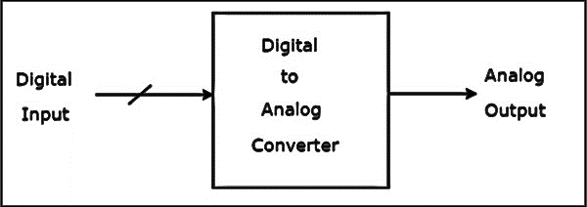
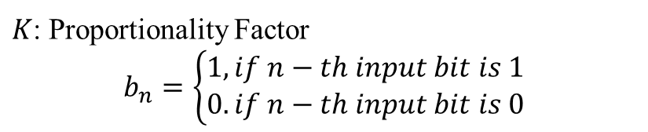
A/D and D/A Converters
A Digital to Analog Converter (DAC) converts a digital input signal (in parallel), into an analog output signal. The digital signal is represented with a binary code, which is a combination of bits 0 and 1.
A Digital to Analog Converter (DAC) consists of a number of binary inputs and a single output.
In general, the number of binary inputs of a DAC will be a power of two.
$$V_{0}=K (2^{N−1}b_{N−1}+2^{N−2}b_{N−2}+…+2^{2}b_{2}+2^{1}b_{1}+b_{0})$$
$K$: Proportionality Factor
$$b_{n}=\left\{\begin{aligned}1, if n−th input bit is 1 \\ 0. if n−th input bit is 0\end{aligned}\right.$$

Slide 4
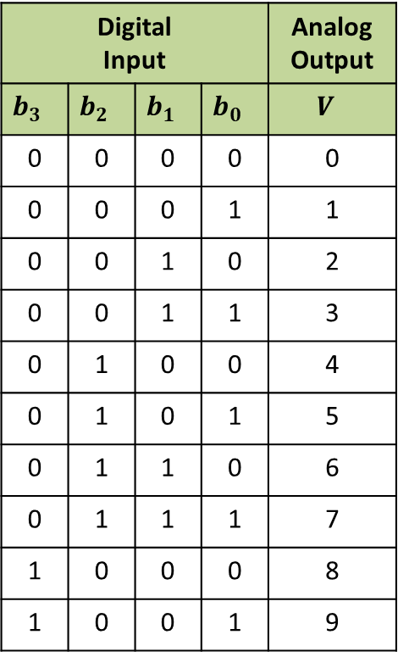
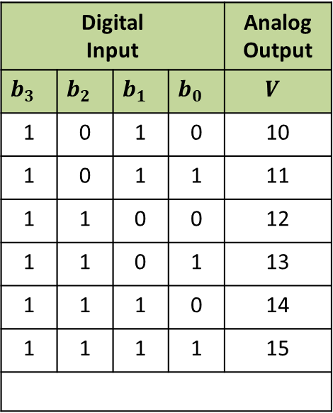
A/D and D/A Converters
Q. Find the analog output voltage of a 4-bit DAC for all possible inputs. Assume K=1
Digital Input |  |  |  | Analog Output
$$b_{3}$$ | $$b_{2}$$ | $$b_{1}$$ | $$b_{0}$$ | $$V$$
0 | 0 | 0 | 0 | 0
0 | 0 | 0 | 1 | 1
0 | 0 | 1 | 0 | 2
0 | 0 | 1 | 1 | 3
0 | 1 | 0 | 0 | 4
0 | 1 | 0 | 1 | 5
0 | 1 | 1 | 0 | 6
0 | 1 | 1 | 1 | 7
1 | 0 | 0 | 0 | 8
1 | 0 | 0 | 1 | 9
Digital Input |  |  |  | Analog Output
$$b_{3}$$ | $$b_{2}$$ | $$b_{1}$$ | $$b_{0}$$ | $$V$$
1 | 0 | 1 | 0 | 10
1 | 0 | 1 | 1 | 11
1 | 1 | 0 | 0 | 12
1 | 1 | 0 | 1 | 13
1 | 1 | 1 | 0 | 14
1 | 1 | 1 | 1 | 15
Common DACs:
Weighted Resistor DAC, &
R-2R Ladder DAC

Slide 5
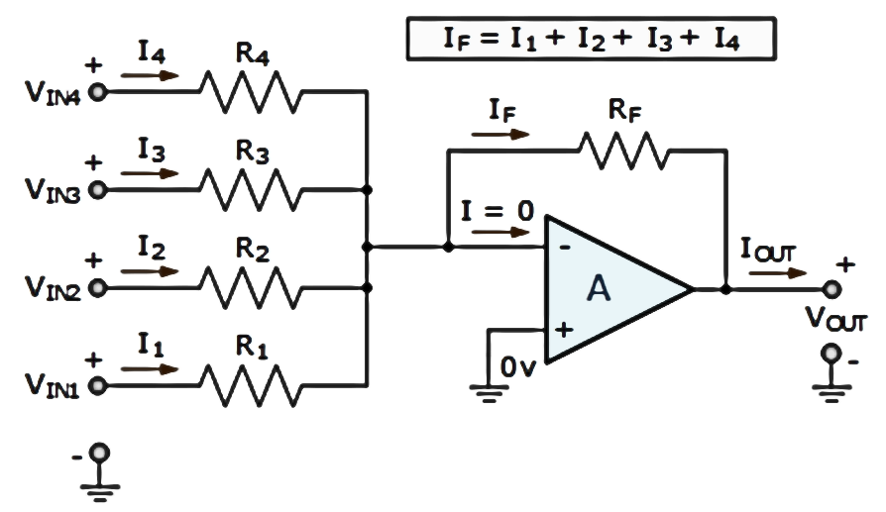
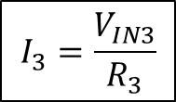
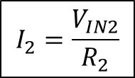
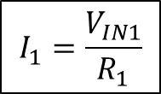
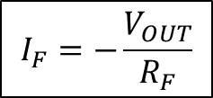
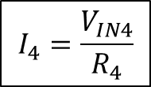
A/D and D/A Converters
Weighted resistor type DAC: Weighted resistors are used along with a summing amplifier.
$$I_{F}=−\frac{V_{OUT}}{R_{F}}$$
$$I_{1}=\frac{V_{IN1}}{R_{1}}$$
$$I_{2}=\frac{V_{IN2}}{R_{2}}$$
$$I_{3}=\frac{V_{IN3}}{R_{3}}$$
$$I_{4}=\frac{V_{IN4}}{R_{4}}$$

Slide 6
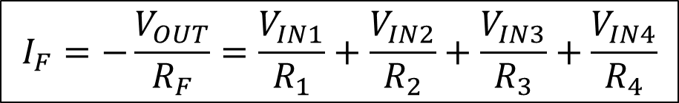

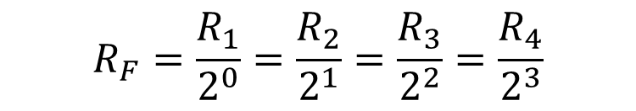
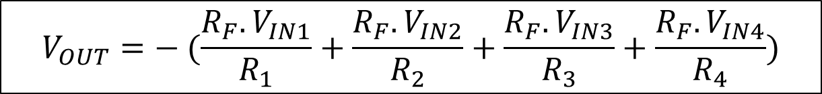
A/D and D/A Converters
$$I_{F}=−\frac{V_{OUT}}{R_{F}}=\frac{V_{IN1}}{R_{1}}+\frac{V_{IN2}}{R_{2}}+\frac{V_{IN3}}{R_{3}}+\frac{V_{IN4}}{R_{4}}$$
$$V_{OUT}=− (\frac{R_{F}.V_{IN1}}{R_{1}}+\frac{{R_{F}.V}_{IN2}}{R_{2}}+\frac{{R_{F}.V}_{IN3}}{R_{3}}+\frac{{R_{F}.V}_{IN4}}{R_{4}})$$
$$R_{F}=\frac{R_{1}}{2^{0}}=\frac{R_{2}}{2^{1}}=\frac{R_{3}}{2^{2}}=\frac{R_{4}}{2^{3}}$$
Weighted resistors
$$V_{OUT}=− (\frac{V_{IN1}}{2^{0}}+\frac{V_{IN2}}{2^{1}}+\frac{V_{IN3}}{2^{2}}+\frac{V_{IN4}}{2^{3}})$$
MSB
LSB

Slide 7

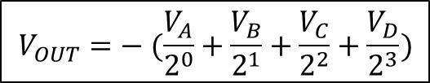


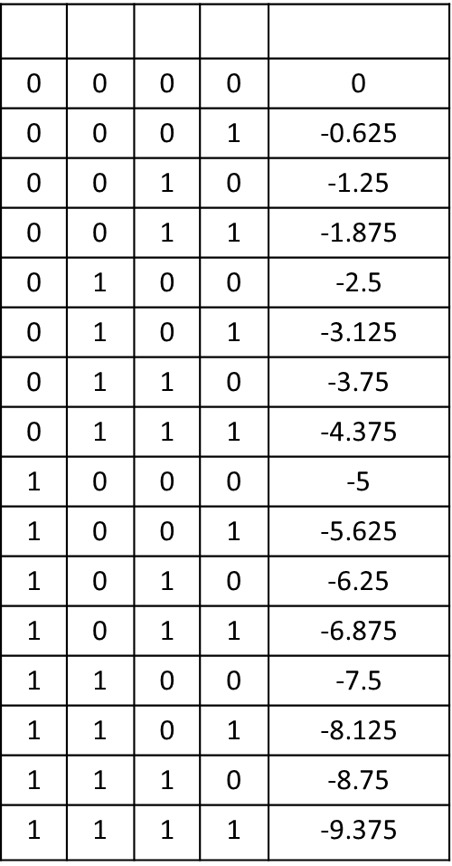
A/D and D/A Converters
$$A$$ | $$B$$ | $$C$$ | $$D$$ | $$V_{OUT}$$
0 | 0 | 0 | 0 | 0
0 | 0 | 0 | 1 | -0.625
0 | 0 | 1 | 0 | -1.25
0 | 0 | 1 | 1 | -1.875
0 | 1 | 0 | 0 | -2.5
0 | 1 | 0 | 1 | -3.125
0 | 1 | 1 | 0 | -3.75
0 | 1 | 1 | 1 | -4.375
1 | 0 | 0 | 0 | -5
1 | 0 | 0 | 1 | -5.625
1 | 0 | 1 | 0 | -6.25
1 | 0 | 1 | 1 | -6.875
1 | 1 | 0 | 0 | -7.5
1 | 1 | 0 | 1 | -8.125
1 | 1 | 1 | 0 | -8.75
1 | 1 | 1 | 1 | -9.375
$$V_{OUT}=− (\frac{V_{A}}{2^{0}}+\frac{V_{B}}{2^{1}}+\frac{V_{C}}{2^{2}}+\frac{V_{D}}{2^{3}})$$
Resolution : $\frac{1}{2^{n}−1}$
MSB
LSB
$$V_{A},V_{B},V_{C},V_{D}= +5V(logic 1), or 0V (logic 0)$$
Step-size: -$0.625 V$
Resolution: $\frac{1}{15}$ ; 4-bit
Drawbacks
requires a very precise value of resistors.
impractical for higher-order DACs
The stability of the device is resistor-dependent
Advantages
It has a simple assembly.
It has a fast conversion speed.
Simple conversion circuit

Slide 8
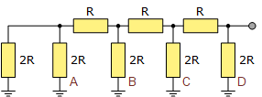
A/D and D/A Converters
R-2R Ladder type DAC: It uses only two values of (precision) resistors to convert a digital binary number into an analog output signal proportional to the digital number's value.
ladder-like configuration
Long strings of parallel and series-connected resistors acting as interconnected voltage dividers along their length,
and whose output voltage depends only on the interaction of the input voltages with each other

Slide 9
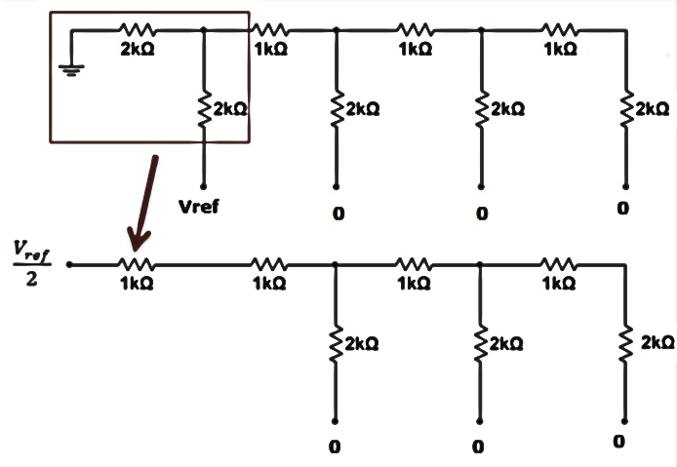
A/D and D/A Converters
Let us consider the digital data D₃D₂D₁D₀= ABCD=1000 is applied to the DAC, then Thevenin’s equivalent circuit reduction is shown below.

Slide 10
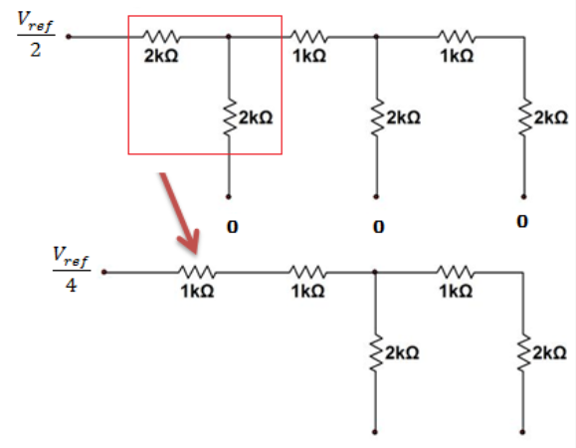
A/D and D/A Converters

Slide 11
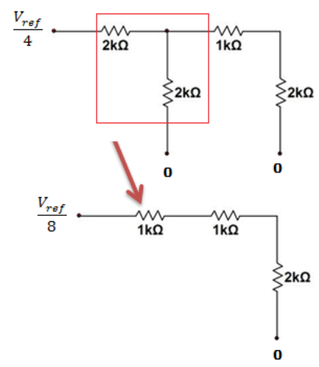
A/D and D/A Converters

Slide 12
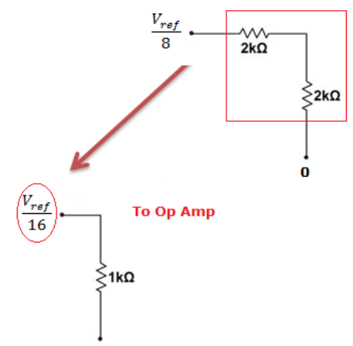
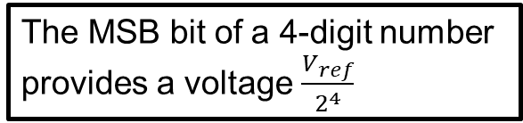
A/D and D/A Converters
The MSB bit of a 4-digit number
provides a voltage $\frac{V_{ref}}{2^{4}}$

Slide 13
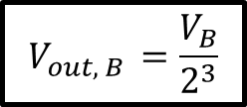
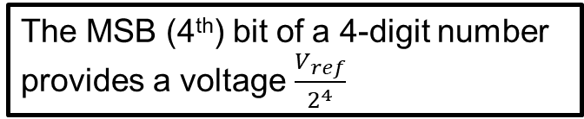
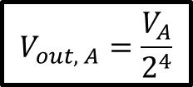
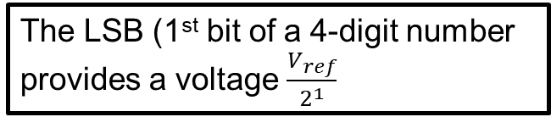
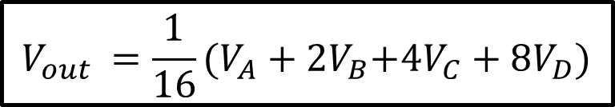
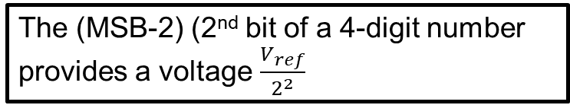
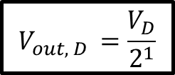
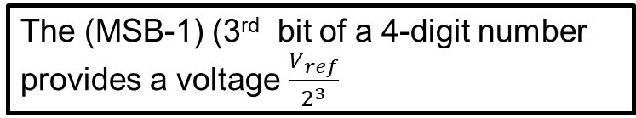
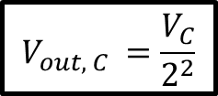
A/D and D/A Converters
The MSB (4th) bit of a 4-digit number
provides a voltage $\frac{V_{ref}}{2^{4}}$
$$V_{out, A}=\frac{V_{A}}{2^{4}}$$
$$V_{out, B }=\frac{V_{B}}{2^{3}}$$
The (MSB-1) (3rd bit of a 4-digit number
provides a voltage $\frac{V_{ref}}{2^{3}}$
$$V_{out, C }=\frac{V_{C}}{2^{2}}$$
The (MSB-2) (2nd bit of a 4-digit number
provides a voltage $\frac{V_{ref}}{2^{2}}$
$$V_{out, D }=\frac{V_{D}}{2^{1}}$$
The LSB (1st bit of a 4-digit number
provides a voltage $\frac{V_{ref}}{2^{1}}$
$$V_{out }=\frac{1}{16}(V_{A}+2V_{B}{+{4V}_{C}+8V}_{D})$$

Slide 14
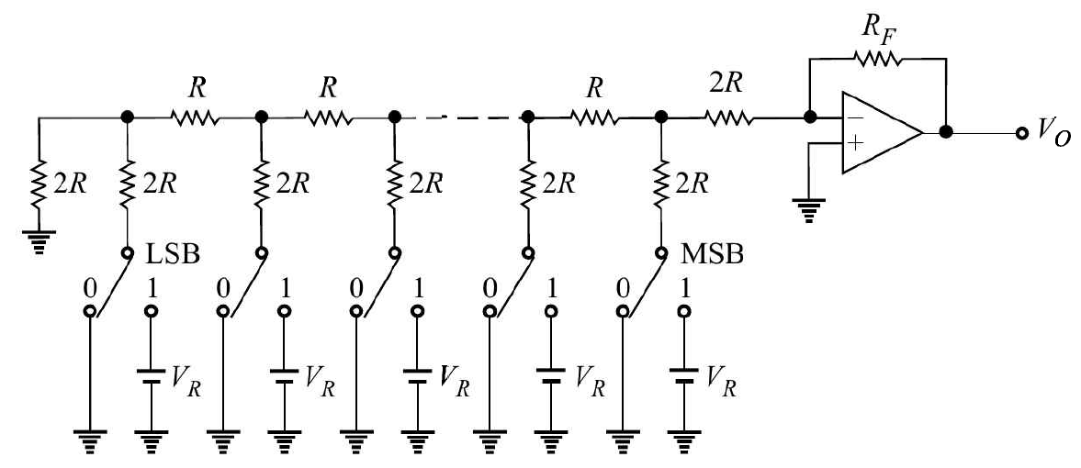
A/D and D/A Converters
A 5-bit R-2R ladder type DAC

Slide 15
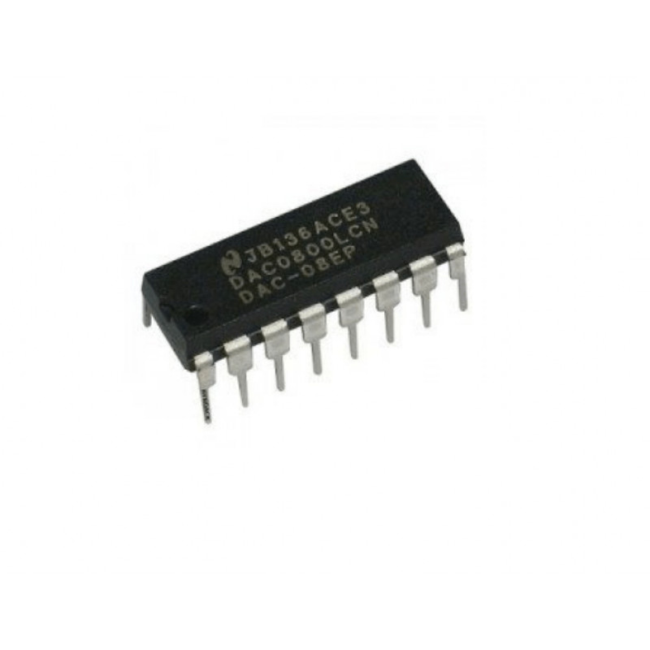
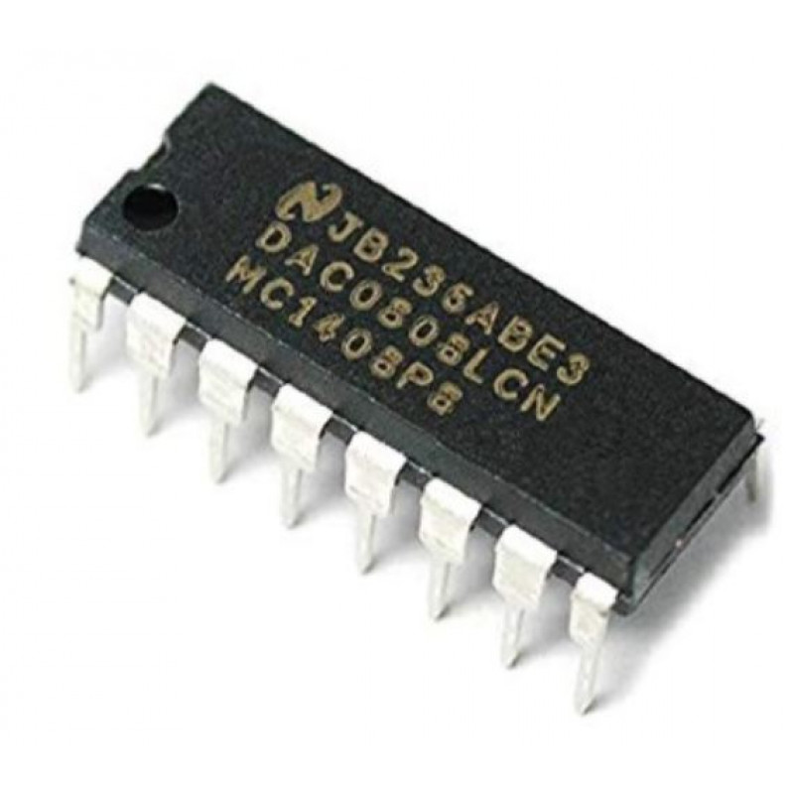
A/D and D/A Converters
Examples of D to A converters IC’s
DAC0800: monolithic 8-bit high-speed current-output DAC
DAC0808: 8-bit monolithic DAC featuring a full-scale output

Slide 16
A/D and D/A Converters
Comparison of DAC’s:
S. No. | Parameter | Weighted Resistor DAC | R-2R Ladder DAC
1 | Simplicity | Simple | Slightly complicated
2 | Range of resistor values | A wide range is required | Resistors of only two values are required
3 | Number of resistor per bit | One | Two
4 | Ease of expansion | Not easy to expand for more bits | Easy to expand

Slide 17
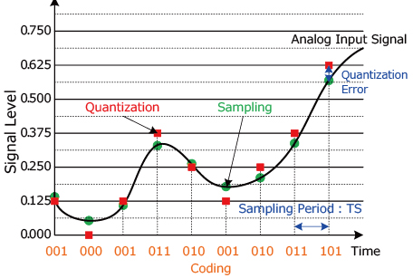
A/D and D/A Converters
An A/D converter is a device that converts analog signals (usually voltage) obtained from environmental (physical) phenomena into digital format. Conversion involves a series of steps, including sampling, quantization, and coding.

Slide 18
A/D and D/A Converters
There are two types of ADCs:
Direct type ADCs, and Indirect type ADC.
The following are examples of Direct type ADCs −
Counter-type ADC
Successive Approximation ADC
Flash-type ADC
Indirect type ADC. It first converts the analog input into a linear function of time (or frequency) and then produces the digital (binary) output.
Dual slope ADC is the best example of an Indirect type ADC.

Slide 19
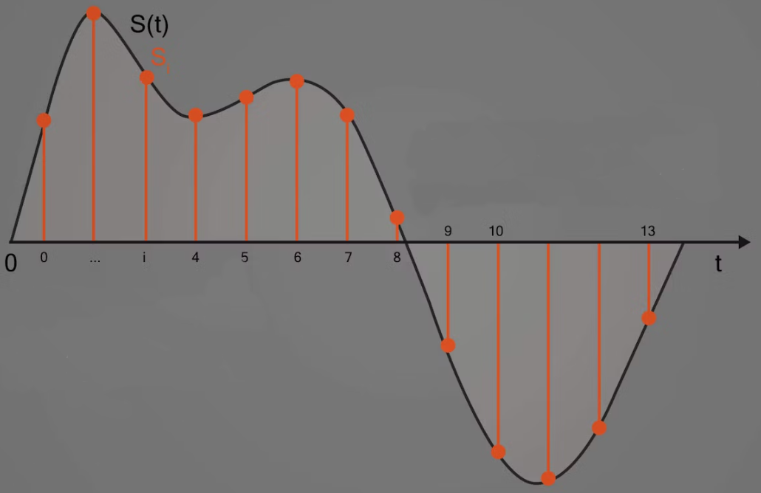
A/D and D/A Converters

Slide 20
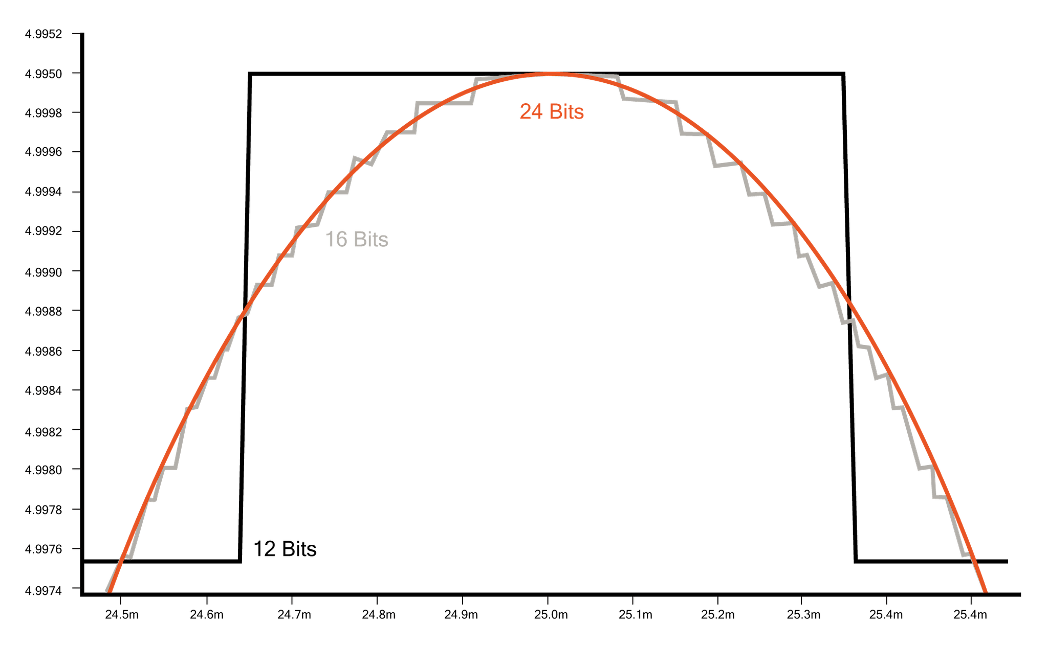
A/D and D/A Converters

Slide 21
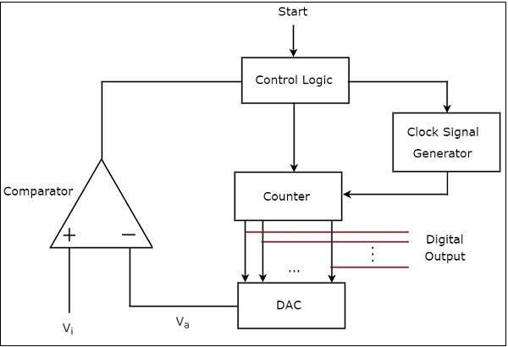
A/D and D/A Converters
A counter-type ADC produces a digital output, which is approximately equal to the analog input by using counter operation internally.

Slide 22
A/D and D/A Converters
Counter-type ADC:
The control logic resets the counter and enables the clock signal generator in order to send the clock pulses to the counter, when it received the start commanding signal.
The counter gets incremented by one for every clock pulse and its value will be in binary (digital) format. This output of the counter is applied as an input of DAC.
DAC converts the received binary (digital) input, which is the output of the counter, into an analog output. The comparator compares this analog value V_{a} with the external analog input value V_{i}
The output of comparator will be ‘1’ as long as 𝑉_{𝑖} is greater than V_{a}. The operations mentioned in the above two steps will be continued as long as the control logic receives ‘1’ from the output of the comparator.
The output of the comparator will be ‘0’ when 𝑉_{𝑖} is less than or equal to V_{a} . So, the control logic receives ‘0’ from the output of the comparator. Then, the control logic disables the clock signal generator so that it doesn’t send any clock pulse to the counter.
At this instant, the output of the counter will be displayed as the digital output. It is almost equivalent to the corresponding external analog input value 𝑉_{𝑖}
.

Slide 23
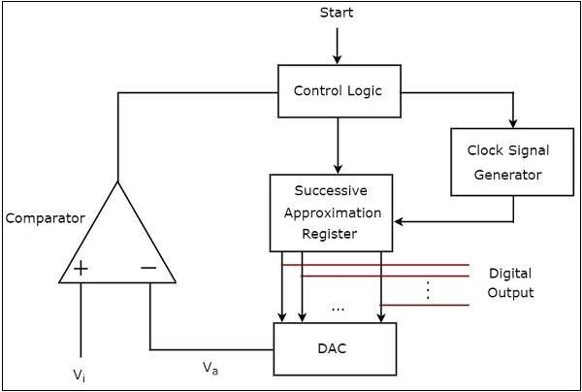
A/D and D/A Converters
Successive Approximation (SAR) ADC: The typical SAR ADC uses a sample-and-hold circuit. The DAC creates an analog reference voltage equal to the digital code output of the sample and hold circuit.
Both of these are fed into a comparator which sends the result of the comparison to the SAR.
This process continues for “n” successive times, with “n” being the bit resolution of the ADC itself until the closest value to the actual signal is found.
Successive Approximation (SAR) ADC

Slide 24
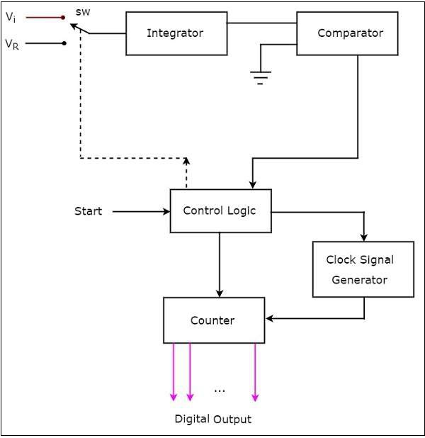
A/D and D/A Converters
Dual Slope ADC

Slide 25
A/D and D/A Converters
The working of a dual-slope ADC is the following −
The control logic resets the counter and enables the clock signal generator in order to send the clock pulses to the counter when it receives the commanding signal.
Control logic pushes the switch SW to connect to the external analog input voltage V_{i}, when it is received the start commanding signal. This input voltage is applied to an integrator.
The output of the integrator is connected to one of the two inputs of the comparator and the other input of the comparator is connected to the ground.
Comparator compares the output of the integrator with zero volts (ground) and produces an output, which is applied to the control logic.
The counter gets incremented by one for every clock pulse and its value will be in binary (digital) format. It produces an overflow signal to the control logic when it is incremented after reaching the maximum count value. At this instant, all the bits of the counter will be having zeros only.
Now, the control logic pushes the switch SW to connect to the negative reference voltage −V_{ref}. This negative reference voltage is applied to an integrator. It removes the charge stored in the capacitor until it becomes zero. At this instant, both the inputs of a comparator are having zero volts. So, the comparator sends a signal to the control logic. Now, the control logic disables the clock signal generator and retains (holds) the counter value.
The counter value is proportional to the external analog input voltage. At this instant, the output of the counter will be displayed as the digital output. It is almost equivalent to the corresponding external analog input value V_{i}.
The dual-slope ADC is used in applications where accuracy is more important while converting analog input into its equivalent digital (binary) data.

Slide 26
A/D and D/A Converters
Examples of ADC ICs:
The ADC0804 are CMOS 8-Bit, successive approximation A/D converters.
The ADC0808 data acquisition component is a monolithic CMOS device with an 8-bit analog-to-digital converter, 8-channel multiplexer, and microprocessor-compatible control logic. The 8-bit A/D converter uses successive approximation as the conversion technique.
The ADC0809 data acquisition component is a monolithic CMOS device with an 8-bit analog-to-digital converter, 8-channel multiplexer, and microprocessor-compatible control logic. The 8-bit A/D converter uses successive approximation as the conversion technique.
The CA3161 is a monolithic integrated circuit that performs the BCD to seven-segment decoding function and features constant current segment drivers.

Slide 27
A/D and D/A Converters
Comparison of A/D Convertors:
ADC type | Pros | Cons | Max resolution | Max sample rate | Main applications
Successive Approximation (SAR) | Good speed/resolution ratio | No inherent anti-aliasing protection | 18 bits | 10 MHz | Data Acquisition
Delta-sigma (ΔΣ) | High dynamic performance, inherent anti-aliasing protection | Hysteresis on unnatural signals | 32 bits | 1 MHz | Data Acquisition, Noise & Vibration, Audio
Dual Slope | Accurate, inexpensive | Low speed | 20 bits | 100 Hz | Voltmeters
Pipelined | Very fast | Limited resolution | 16 bits | 1 GHz | Oscilloscopes
Flash | Fastest | Low bit resolution | 12 bits | 10 GHz | Oscilloscopes

